Slide 1
What is F# and why should I care?
Mike O’Brien
@hcoverlambda
blog.mikeobrien.net

Slide 2
What is F#?
F# is primarily a functional language.
It is multi paradigm so it does allow you to code/consume imperative and OO code.
It’s a .NET language so…
You get all the benefits of the .NET framework.
It can plug right into an existing .NET ecosystem.
It has its roots in ML, a functional language created in the ‘70s.
It ships with VS2010 and is offered as a stand alone download for VS2008 and the CLI.

Slide 3
Why should I care?
For most of us the reason we should care has to do with the functional paradigm, not about F# per se.
Learning the functional paradigm will fundamentally change how you approach and solve computing problems.
I will not be able to prove this to you in 45 minutes.
The only way to truly learn the functional paradigm is in a functional language (Doesn't have to be F#).
Even though learning the functional paradigm is done in a functional language the functional paradigm can be applied in multi paradigm languages that support functional constructs like C# and Ruby.

Slide 4
Programming Paradigms
What is a “programming paradigm”?
“A fundamental style of computer programming” - Wikipedia
Suite of interrelated concepts, idioms, principles and patterns.
Values (IE: Elegance, simplicity, performance, quality, terseness, flexibility, speed of development, parallel computation, managing complexity, etc.)
They embody a lot of stuff.
The functional paradigm is made up of all that stuff too.
The functional paradigm is not a particular language.
A language enables you to express a particular paradigm.

Slide 5
Paradigm Shift
Learning the functional paradigm is not about learning a new language syntax!
If you just do that your not gaining anything.
If you are a OO developer you will initially find it hard to “think functionally”.
Your instincts will be wrong at first, don’t trust them!
Look for a functional way to solve the problem.
Don’t give up, you’ll get it!

Slide 6
Immutability
In other words, you cant change it (Or “mutate” it) after it’s been set.
Thus we talk about “values” and not “variables” (Because it cant vary).
This can be overridden with the “mutable” keyword and using the “<-” assignment operator. (But prolly means ur doing it wrong)
This is not a bad thing. The functional paradigm solves problems in such a way that doesn't require the maintenance of mutable state whereas imperative/OO is all about it.
This simplifies and clarifies the code.
Opens the door for easy parallelization (Nothing to lock, no race conditions, etc).

Slide 7

Type Inference
F# is strongly typed.
Makes heavy use of type inference.
In fact you RARELY have to specify a type.
F# attempts to generalize types, by making them generic, when possible (Automatic Generalization).
C# has limited type inference
With local variables via the “var” keyword.
With generic type parameters.
“But, but, I need types, this is weird!”
Working in F# helps you realize that explicit type specifications ARE NOT important and not needed.
But this is well engrained so its hard to let go.

Slide 8
First-class & Higher-order Functions
First-class functions are treated just like primitives and other data types.
They can be passed into and returned by other functions.
Higher-order functions are simply functions that take a function as a parameter or return a function.

Slide 9
Lambdas
Lambda expressions, aka lambda functions, aka lambdas, aka anonymous functions are first-class functions that are not bound to an identifier.
So in other words they aren't given a name but defined “on the fly”.
In C# these are called “lambda expressions”, in F# “lambda functions”.
They can be assigned to a value (F#) or variable (C#) or passed directly to another function.
They are compact and terse.

Slide 10
Closures
Closures are first-class functions that lift values/variables from the scope in which they are declared.
This would include local values/variables scoped to a function (Who’s scope lasts only the life of the function because the values are on the stack).
This would not include class level values/variables as their scope lives on (On the heap) as long as there is a reference to the object.
The values are “closed over”. In C#/F# this means the compiler generates a class with a copy of the values from the scope that goes along with the first-class function.
If no values are lifted from their scope its not a closure.
Technically a closure doesn't have to be a lambda and a lambda doesn't have to be a closure. The concepts are orthogonal!
In practice however (With C# & F#) the concept of closures is only relevant to lambdas, as other first-class functions do not need variables in their scope to be lifted.
Because of this, colloquially the term “lambda” and “closure” are used interchangeably.

Slide 11
Currying/Partial Application

Slide 12
Lazy Evaluation

Slide 13
Recursion

Slide 14
Declarative
Largely declarative (Focusing on what not how).

Slide 15
Pipelining

Slide 16
Pattern Matching

Slide 17
List Processing

Slide 18
Sequence Expressions

Slide 19
Workflows

Slide 20
Applied F#
“If F# (Or any functional language) is not supplanting my day to day OO language where can I use it?”
Prototyping
Scripting (Yes, F# scripting!)
Build scripts (FAKE, F# Make: http://bitbucket.org/forki/fake/wiki/Home)
Short lived tools (In application or script form)
Personal projects (Including MVC and Silverlight projects)
OSS projects
Project Euler (http://projecteuler.net/)
Make use of the functional paradigm in your multi paradigm OO language to solve problems.

Slide 21
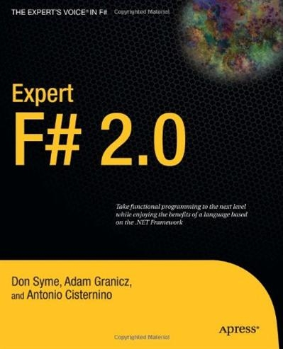
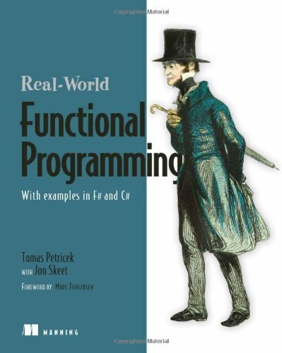
Learning Resources
Blogs
Don Syme - http://blogs.msdn.com/b/dsyme/
Tomas Petricek - http://tomasp.net/blog/
Books

Slide 22

That’s all folks…
Slides, downloads and links @ http://blog.mikeobrien.net

